Slide 1
Programming 1 - WEEK 3
Strings

Slide 2


Slide 3

Recap
Arithmetic
Booleans
Conditionals
None

Slide 4

Permanent Evaluation
Be quiet - no talking
Don't cheat
Look at your own screen
ONLY allowed to be on ANS
No GenAI – No VSCode – ...
No ppt – No notes – ...
Browser full screen
Display Light 100%
Guess correction: -0.5 / +1
Close your laptop when finished

Slide 5
Programming 1 - WEEK 3
Strings

Slide 6

Data types
Dealing with numbers
int
float
Dealing with True/False
boolean
Dealing with text
string

Slide 7

Strings – The basics
Single or double quotes

Slide 8

Strings – The basics
Single or double quotes
Case sensitivity

Slide 9

Strings – The basics
Single or double quotes
Case sensitivity
Interpolation
Terminal:

Slide 10
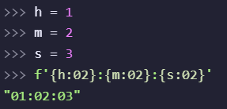


Strings – The basics
Single or double quotes
Case sensitivity
Interpolation
Formatting

Slide 11
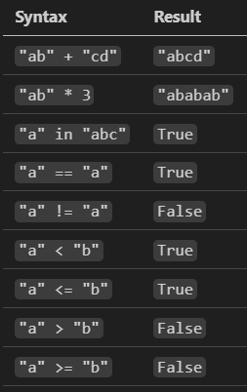



Strings – The basics
Single or double quotes
Case sensitivity
Interpolation
Formatting
Operators

Slide 12
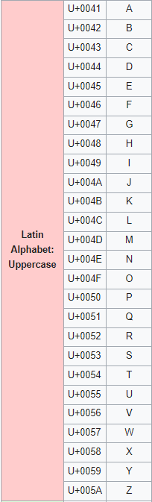
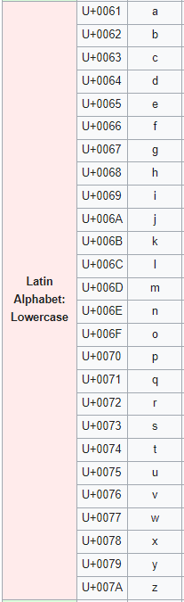
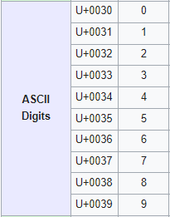
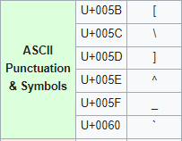
Unicode

Slide 13



Strings – The basics
Single or double quotes
Case sensitivity
Interpolation
Formatting
Operators
Escape Characters

Slide 14
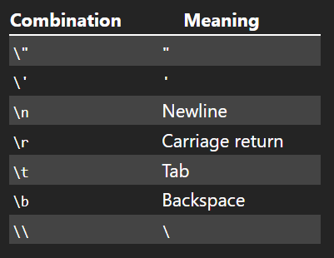
Strings – The basics
Single or double quotes
Case sensitivity
Interpolation
Formatting
Operators
Escape Characters

Slide 15
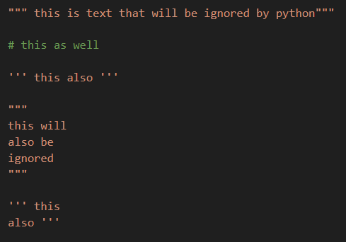
Strings – The basics
Single or double quotes
Case sensitivity
Interpolation
Formatting
Operators
Escape Characters
Documentation

Slide 16

Strings – The basics
Single or double quotes
Case sensitivity
Interpolation
Formatting
Operators
Escape Characters
Documentation
Functions

Slide 17

Strings – Functions
print() → output data to the terminal

Slide 18


Strings – Functions
print()
input() → receive data from the terminal
→ data is captured as a string

Slide 19

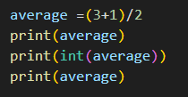

Strings – Functions
print()
input()
int()

Slide 20

Strings – Functions
print()
input()
int()
float()

Slide 21


Strings – Functions
print()
input()
int()
float()
str()

Slide 22

Strings – Functions
print()
input()
int()
float()
str()
len()

Slide 23

Strings – The real deal
Indexing
Slicing
Methods

Slide 24
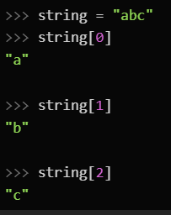
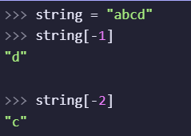
Strings - Indexing
A string can be seen as a sequence of characters. You can access each of these characters individually.
using indexing:
Zero based → First element has index zero!

Slide 25

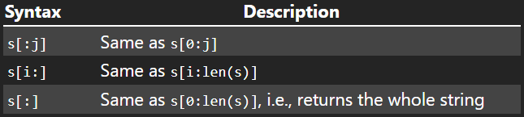
Strings - Slicing
from index 0 (included)
to index 3 (excluded)
Other possibilities:

Slide 26

Strings - Slicing
“abcdefg”[1:4:2] → “bd”
“abcdefg”[::2] → “aceg”
“abcdefg”[4:1:-1] → “edc”
“abcdefg”[::-1] → “gfedcba”

Slide 27
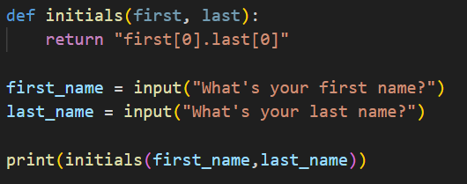
Strings
→ Why is this not working properly… ?

Slide 28
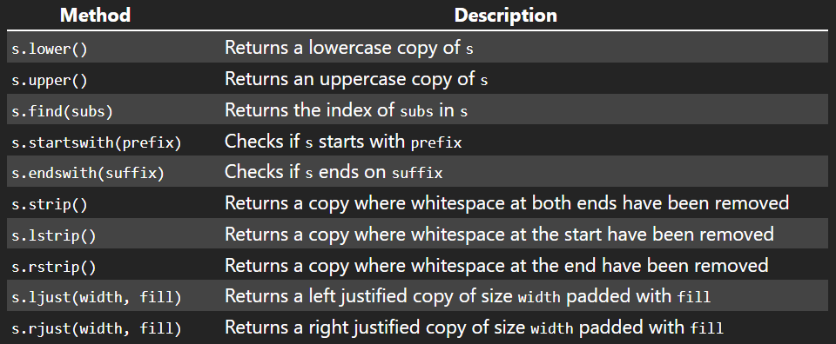
Strings - Methods
→ -1 if not found

Slide 29
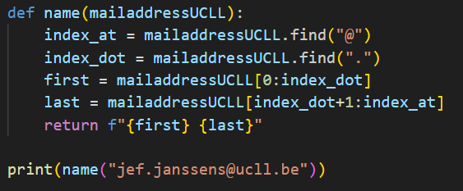
Strings
→ Why is this not working properly… ?

Slide 30
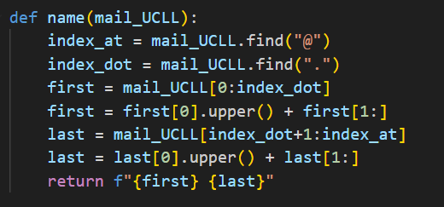
Strings
→ How do we capitalize first and last name?

Slide 31

Strings – DEMO
We consider an email address valid when it meets the following simplified requirements:
It must contain an @, which cannot be at the first position
There must be at least one letter right after the @
The address must end with a . followed by exactly 2 characters
Write a function valid_email(email) that returns a string that tells us whether the given email address is valid or invalid as follows: “<<email>> is valid” or “<<email>> is invalid”.

Slide 32
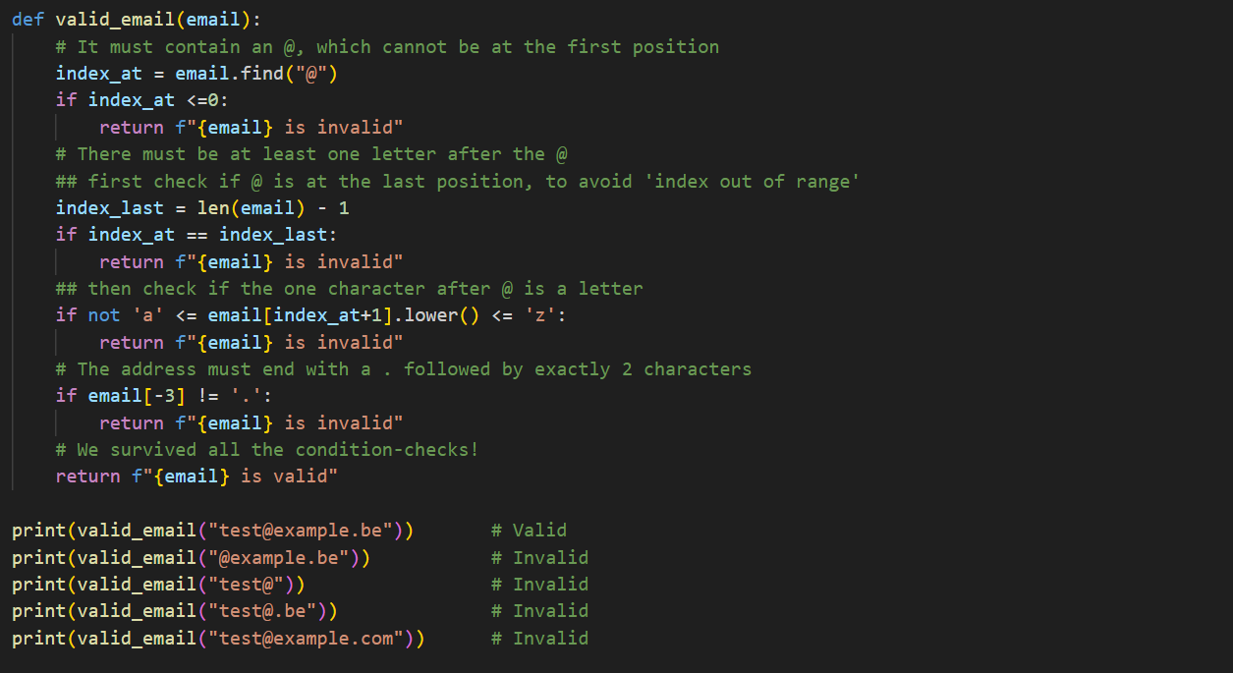
String - DEMO

Slide 33

Questions?
git pull

Slide 34
Strings – DEMO
We consider an email address valid when it meets the following simplified requirements:
It must contain an @, which cannot be at the first position
There must be at least one letter right after the @
The address must end with a . followed by exactly 2 characters
Write a function valid_email(email) that returns a string that tells us whether the given email address is valid or invalid as follows: “<<email>> is valid” or “<<email>> is invalid”.

